Slide 1


Ugur Selim Ozen
01.09.2022

Slide 2

Outline
Executive Summary
Introduction
Methodology
Results
Conclusion
Appendix

Slide 3
Executive Summary
Summary of methodologies
Collect the data with web scraping or SpaceX API
Data Wrangling & EDA with Data Visualization
Model Building & Predicting & Interpreting Results
Summary of all results
- As seen from the test data accuracy results ; while KNN , SVM , the Desicion Tree Classifier and Logistic Regression have the same accuracy which is %83.33 after using best_params for them.

Slide 4
Introduction
In this capstone Project, we will predict if the Falcon 9 first stage will land successfully. SpaceX advertises Falcon 9 rocket launches on its website with a cost of 62 million dollars; other providers cost upward of 165 million dollars each, much of the savings is because SpaceX can reuse the first stage. Therefore, if we can determine if the first stage will land, we can determine the cost of a launch. This information can be used if an alternate company wants to bid against SpaceX for a rocket launch.

Slide 5


Slide 6
Methodology
Executive Summary
Data collection methodology:
Data was collected via SpaceX API and using web scraping
Perform data wrangling
Exploratory Data Analysis , Determine Training Labels
Perform exploratory data analysis (EDA) using visualization and SQL
Perform interactive visual analytics using Folium and Plotly Dash
Perform predictive analysis using classification models
Create a column for the class , Standardize the data , Split into training data and test data , Find best Hyperparameter for SVM, Classification Trees and Logistic Regression , Find the method performs best using test data

Slide 7
Data Collection
Data sets were collected by using two methods ;
Web Scraping using requests and beautifulsoup
Requesting data with SpaceX API

Slide 8
Data Collection – SpaceX API
getBoosterVersion ()
getLaunchSite ()
getPayLoadData ()
getCoreData ()
Source

Slide 9
Data Collection - Scraping
date_time ()
booster_version ()
landing_status ()
get_mass ()
extract_column_from_header ()
Source

Slide 10
Data Wrangling
We will perform some Exploratory Data Analysis (EDA) to find some patterns in the data and determine what would be the label for training supervised models.
In the data set, there are several different cases where the booster did not land successfully. Sometimes a landing was attempted but failed due to an accident; for example, True Ocean means the mission outcome was successfully landed to a specific region of the ocean while False Ocean means the mission outcome was unsuccessfully landed to a specific region of the ocean. True RTLS means the mission outcome was successfully landed to a ground pad False RTLS means the mission outcome was unsuccessfully landed to a ground pad. True ASDS means the mission outcome was successfully landed on a drone ship False ASDS means the mission outcome was unsuccessfully landed on a drone ship.
We will mainly convert those outcomes into Training Labels with 1 means the booster successfully landed 0 means it was unsuccessful.
Source

Slide 11
EDA with Data Visualization
We will perform Exploratory Data Analysis using Pandas and Matplotlib between following relationships to see some patterns and linearity ;
Flight number and Launch site
Payload and Launch site
Success rate and Orbit type
Flight number and Orbit type
Payload and Orbit type
Success rate and Year
Source

Slide 12
EDA with SQL
select distinct(LAUNCH_SITE) from SPACEXTBL
select * from SPACEXTBL where LAUNCH_SITE LIKE 'CCA%' limit 5
select sum(PAYLOAD_MASS__KG_) from SPACEXTBL where CUSTOMER = 'NASA (CRS)’
select avg(PAYLOAD_MASS__KG_) from SPACEXTBL where BOOSTER_VERSION = 'F9 v1.1’
select DATE from SPACEXTBL where LANDING__OUTCOME = 'Success (ground pad)' order by DATE limit 1
select BOOSTER_VERSION from SPACEXTBL where (LANDING__OUTCOME = 'Success (drone ship)') and (PAYLOAD_MASS__KG_ > 4000) and (PAYLOAD_MASS__KG_ < 6000)
select count(*) as Successful_Mission_Number from SPACEXTBL where LANDING__OUTCOME like 'Success%’
select count(*) as Failure_Mission_Number from SPACEXTBL where LANDING__OUTCOME like 'Failure%'
select BOOSTER_VERSION from SPACEXTBL where PAYLOAD_MASS__KG_ = (select max(PAYLOAD_MASS__KG_) from SPACEXTBL)
select BOOSTER_VERSION , LAUNCH_SITE from SPACEXTBL where (LANDING__OUTCOME = 'Failure (drone ship)') and (DATE >= '2015-01-01') and (DATE < '2016-01-01’)
select LANDING__OUTCOME , count(*) as Occuring_Number from SPACEXTBL where (DATE > '2010-06-04') and (DATE < '2017-03-20') group by LANDING__OUTCOME order by count(*) desc
Source

Slide 13
Build an Interactive Map with Folium
I added following objects to a folium map to create an interactive visualization on data for understanding problem clearly ;
Marker
Circle
Line
Source

Slide 14
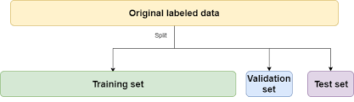
Predictive Analysis (Classification)
I have followed machine learning process given below ;
Create a column for the class
Standardize the data
Split into training data and test data
Find best Hyperparameter for SVM, Classification Trees and Logistic Regression
Find the method performs best using test data
%60 %20 %20
Source

Slide 15
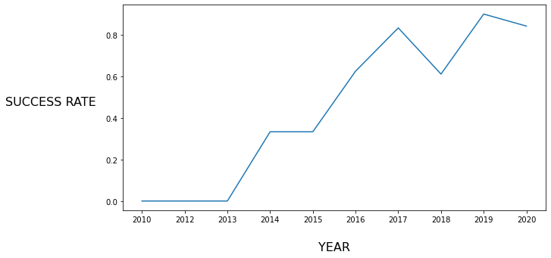
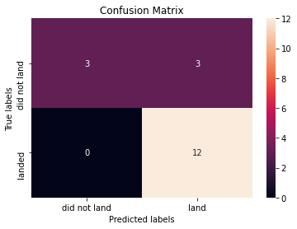
Results

Slide 16


Slide 17
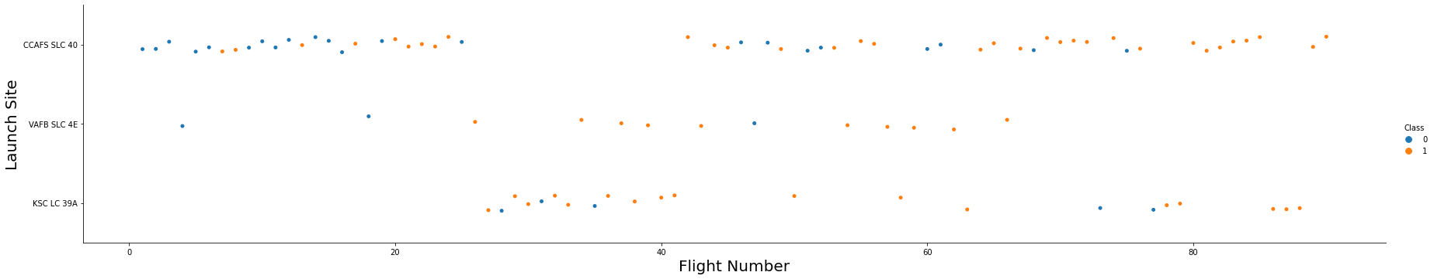
Flight Number vs. Launch Site
Now if you observe Flight Number Vs. Launch Site scatter point chart you will find only the VAFB-SLC 4E launch site has relationship when increasing flight number result with successful landing.

Slide 18
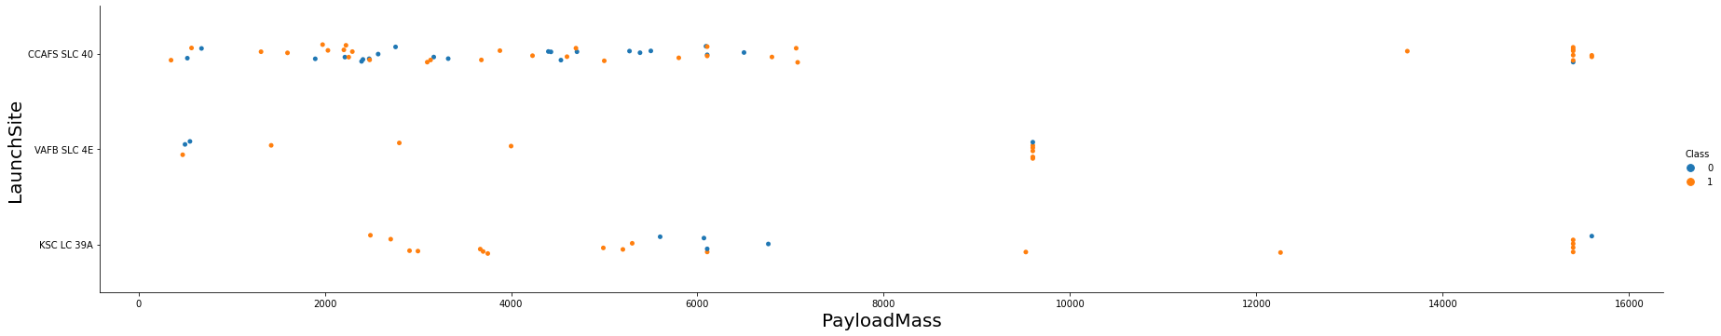
Payload vs. Launch Site
Now if you observe Payload Vs. Launch Site scatter point chart you will find for the VAFB-SLC launch site there are no rockets launched for heavy payload mass(greater than 10000).

Slide 19
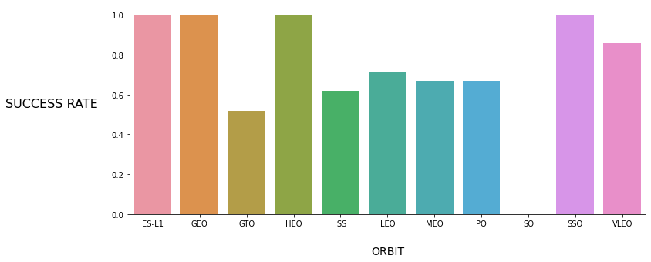
Success Rate vs. Orbit Type
As seen from the bar chart , ES-L1 / GEO / HEO / SSO orbits have the highest success rate (%100) for landing mission but the SO orbit has the lowest one which is %0.

Slide 20
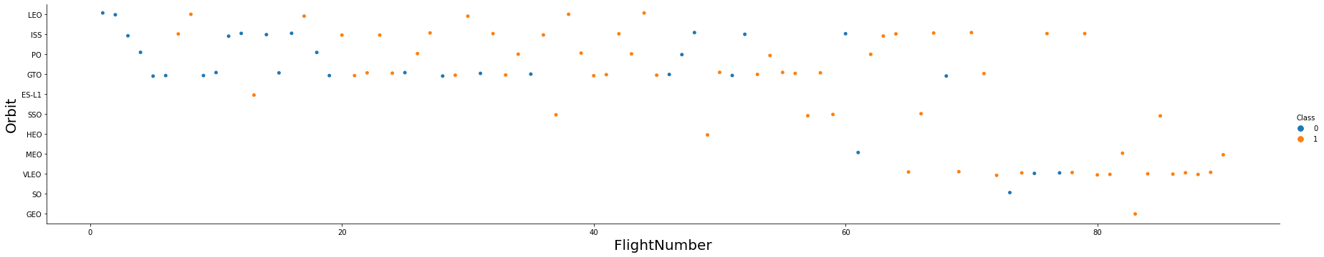
Flight Number vs. Orbit Type
You should see that in the LEO orbit the Success appears related to the number of flights; on the other hand, there seems to be no relationship between flight number when in GTO orbit.

Slide 21
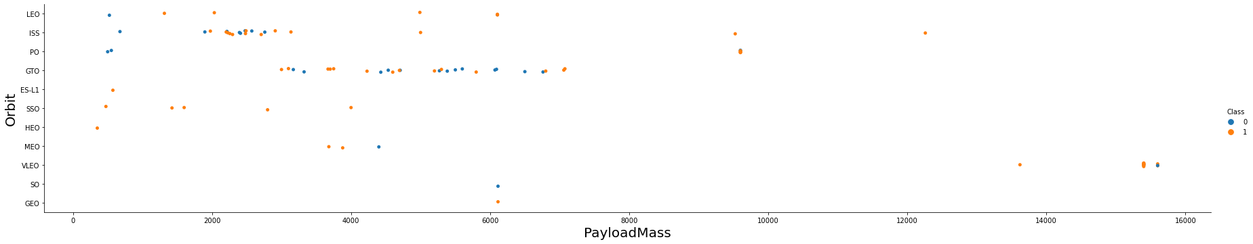
Payload vs. Orbit Type
With heavy payloads the successful landing or positive landing rate are more for Polar, LEO and ISS.However for GTO we cannot distinguish this well as both positive landing rate and negative landing(unsuccessful mission) are both there here.

Slide 22
Launch Success Yearly Trend
You can observe that the success rate since 2013 kept increasing till 2020.

Slide 23
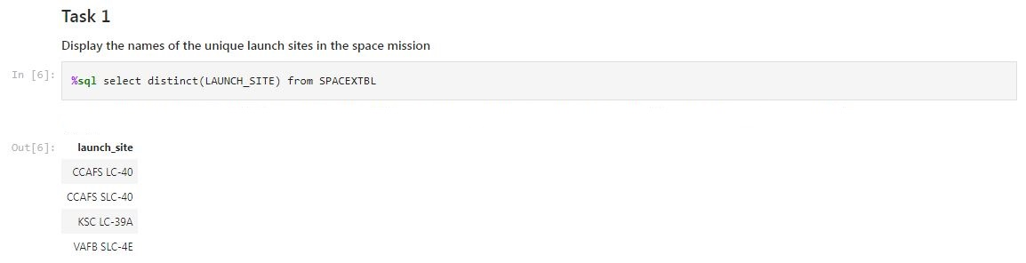
All Launch Site Names
To take unique launch site names , I used DISTINCT function in sql query.

Slide 24
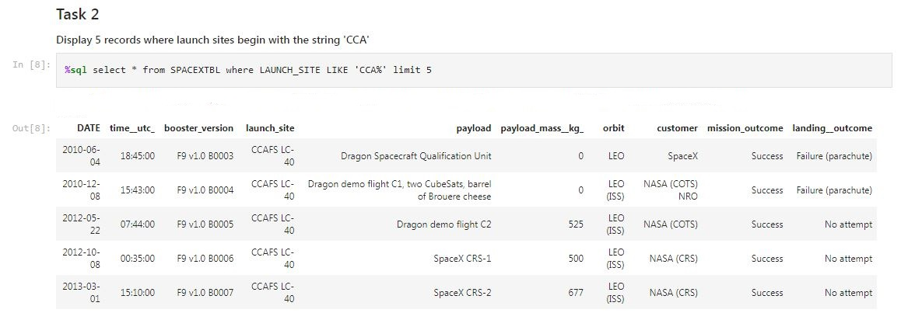
Launch Site Names Begin with 'CCA'
To take only 5 records where launch sites begin with `CCA` , I used LIMIT 5 and LIKE keywords in sql query.

Slide 25
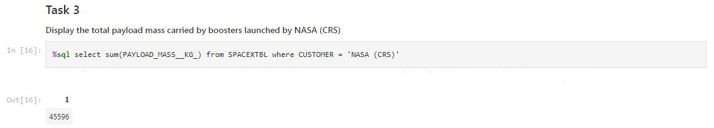
Total Payload Mass
To calculate the total payload carried by boosters from NASA , I used WHERE filtering on customer column and SUM function in sql query.

Slide 26
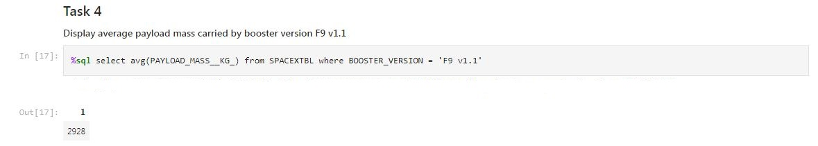
Average Payload Mass by F9 v1.1
To calculate the average payload mass carried by booster version F9 v1.1 , I used AVG function WHERE filtering on booster_version.

Slide 27
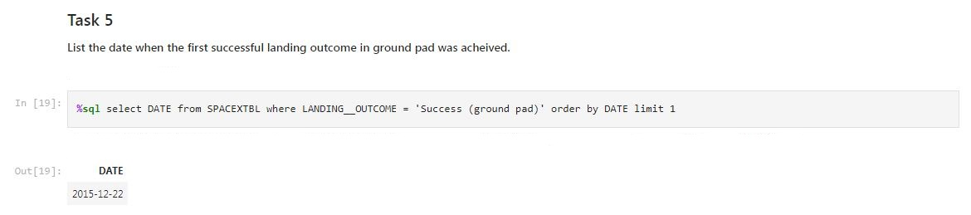
First Successful Ground Landing Date
To find the dates of the first successful landing outcome on ground pad , I used WHERE filtering on landing_outcome with ORDER BY and LIMIT keyword in sql query.

Slide 28
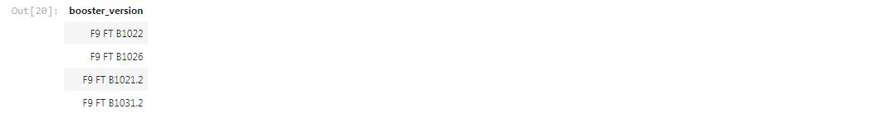
Successful Drone Ship Landing with Payload between 4000 and 6000
To list the names of boosters which have successfully landed on drone ship and had payload mass greater than 4000 but less than 6000 , I used WHERE filtering and AND logical operator in sql query.
select BOOSTER_VERSION from SPACEXTBL where (LANDING__OUTCOME = 'Success (drone ship)') and (PAYLOAD_MASS__KG_ > 4000) and (PAYLOAD_MASS__KG_ < 6000)

Slide 29
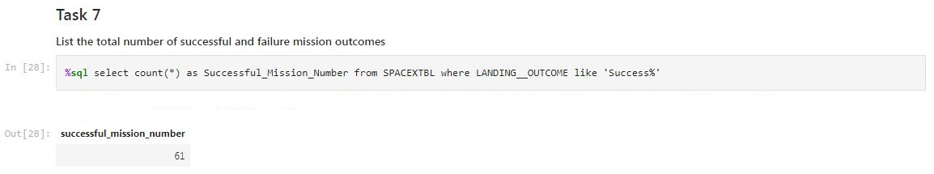
Total Number of Successful and Failure Mission Outcomes
To calculate the total number of successful and failure mission outcomes , I used COUNT function and WHERE filtering with LIKE keyword in sql query.

Slide 30
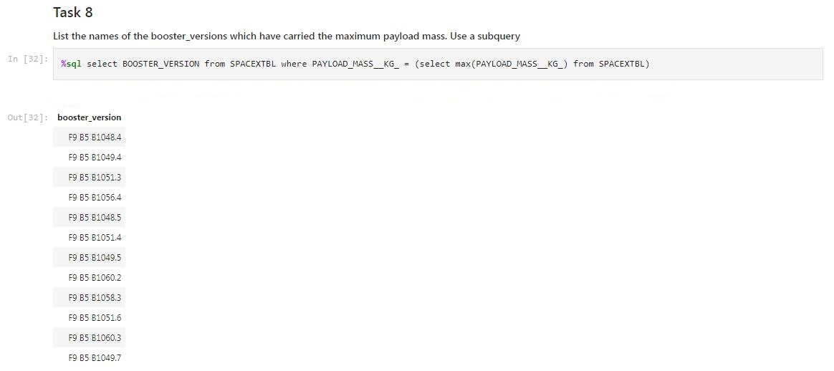
Boosters Carried Maximum Payload
To list the names of the booster which have carried the maximum payload mass , I used subquery with WHERE keyword in sql query.

Slide 31

2015 Launch Records
To list the failed landing_outcomes in drone ship, their booster versions, and launch site names for in year 2015 , I used WHERE filtering and AND logical operator in sql query.
select BOOSTER_VERSION , LAUNCH_SITE from SPACEXTBL where (LANDING__OUTCOME = 'Failure (drone ship)') and (DATE >= '2015-01-01') and (DATE < '2016-01-01’)

Slide 32
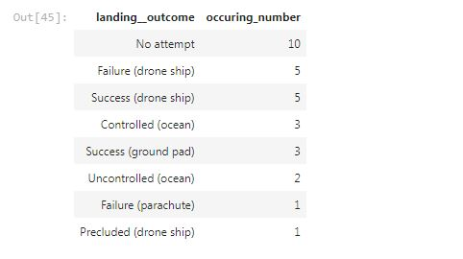
Rank Landing Outcomes Between 2010-06-04 and 2017-03-20
To rank the count of landing outcomes (such as Failure (drone ship) or Success (ground pad)) between the date 2010-06-04 and 2017-03-20, in descending order , I used COUNT function ,WHERE filtering with AND logical operator also ORDER BY keyword in sql query.
select LANDING__OUTCOME , count(*) as Occuring_Number from SPACEXTBL where (DATE > '2010-06-04') and (DATE < '2017-03-20') group by LANDING__OUTCOME order by count(*) desc

Slide 33


Slide 34

Folium Map of All Launch Sites
In this folium map , there is 4 Launch sites totally.

Slide 35

Folium Map of Color Labeled Launch Outcomes
In this folium map , visualized the all-Launch’s classes.

Slide 36

Folium Map of Launch Site Distances
In this folium map , visualized of distance from Launch site to beach.

Slide 37


Slide 38
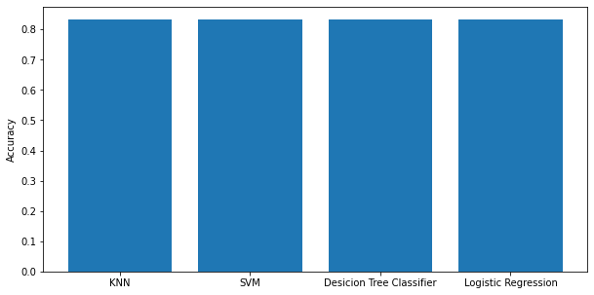
Classification Accuracy
As seen from the bar chart , all 4 classification models have the same accuracy value.

Slide 39
Confusion Matrix
Every 4 ML algorithms gave us same Confusion Matrix result because of the data size which is too small. But we need to focus specially on precision-recall and F1-score values not on accuracy.From the Confusion Matrix results , we would decrease False Positive values in this case.

Slide 40
Conclusions
It is very important to collect data in a simplest and accurate way.
Most important and time-consumed part of the Project was data collection – data cleaning and feature engineering steps.
Every machine learning algorithms have some powerful sides to beat one against to all for different cases.
We should focus on the business outcome and benefits of the model not on the only model success or score !

Slide 41
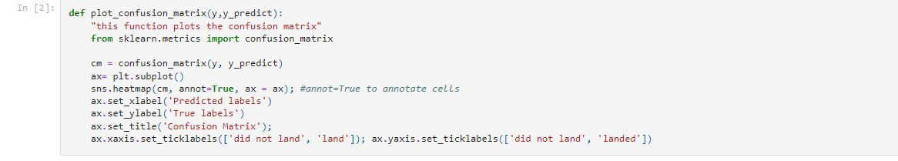
Appendix
Confusion Matrix visualization function

Slide 42


